Slide 1
Keylogger and SECURITY
CAPSTONE PROJECT
Presented By:
P.NARESH ANAND
MADHA ENGINEERING COLLEGE
B.E-COMPUTER SCIENCE AND ENGINEERING

Slide 2
OUTLINE
Problem Statement
Proposed System/Solution
System Development Approach
Algorithm & Deployment
Result (Output Image)
Conclusion
Future Scope
References

Slide 3
Problem Statement
Design a system capable of password cracking through the implementation of a keylogger. The system should clandestinely record all keystrokes entered by a user on a target system without their awareness. It must reliably capture alphanumeric characters, special symbols, and function keys pressed during user interaction with the target system.

Slide 4
Proposed Solution
Use Antivirus and Anti-Malware Software: Install reputable antivirus and anti-malware software on your computer and keep it up to date. These programs can help detect and remove keyloggers and other malicious software.
Keep Software Updated: Ensure that your operating system, web browsers, and other software applications are regularly updated with the latest security patches. Vulnerabilities in outdated software can be exploited by malware, including keyloggers.
Exercise Caution with Email Attachments and Links: Avoid opening email attachments or clicking on links from unknown or suspicious sources. Malicious attachments and links can be used to distribute keyloggers and other malware.
Use Strong, Unique Passwords: Create strong, complex passwords for your accounts and avoid using the same password across multiple accounts. This minimizes the impact if one of your passwords is compromised.
Enable Two-Factor Authentication (2FA): Enable two-factor authentication wherever possible, especially for sensitive accounts such as email, banking, and social media. 2FA adds an extra layer of security by requiring a second form of verification in addition to your password.
Be Wary of Public Computers and Networks: Avoid logging into sensitive accounts on public computers or using public Wi-Fi networks for activities that involve entering passwords.
Use Virtual Keyboards: When entering passwords on public or shared computers, consider using the virtual keyboard provided by the operating system. Virtual keyboards can help prevent keyloggers from capturing your keystrokes.

Slide 5
System Approach
The "System Approach" section outlines the overall strategy and methodology for Keyloggers can be implemented using various technologies, including
Software Keyloggers
Hardware Keyloggers
Kernel-level Keyloggers
Remote Keyloggers
Memory Injection Techniques

Slide 6
Algorithm & Deployment
Keyloggers work by intercepting and recording keystrokes entered by a user on a computer or mobile device. Here's a simplified overview of how a keylogger might operate:
Keystroke Capture: The keylogger captures every keystroke made by the user, including letters, numbers, special characters, and function keys. This information is typically logged locally or sent to a remote server controlled by the attacker.
Data Storage: Captured keystrokes are stored in a log file or database for later retrieval. This log file may contain timestamps indicating when each keystroke was made, as well as information about the application or website where the keystroke occurred.
Stealth Mode: Many keyloggers operate in stealth mode to avoid detection by the user. They may hide their presence from the operating system, disguise their process names, or encrypt their communication with remote servers to evade detection by antivirus software or security tools.
Remote Access: Some keyloggers are designed to send captured keystrokes to a remote server controlled by the attacker. This allows the attacker to monitor the victim's activities in real-time and retrieve sensitive information such as passwords, credit card numbers, or personal messages.
Persistence: To ensure long-term access to the victim's information, keyloggers may install themselves persistently on the victim's system, so they continue to capture keystrokes even after system reboots or software updates.

Slide 7
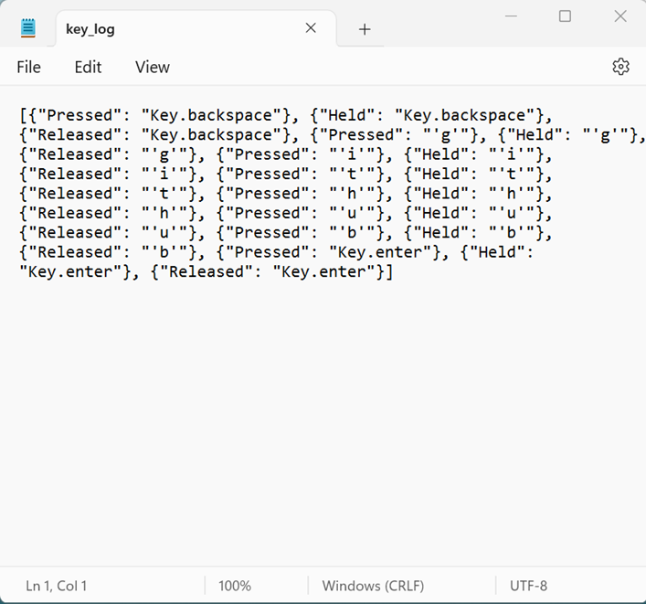

Result
Protect yourself from keyloggers by regularly updating your antivirus software, being cautious of suspicious email attachments and links, and using a firewall to monitor network traffic.

Slide 8
Conclusion
Password cracking poses serious security risks and can lead to unauthorized access to sensitive information. It is essential to use strong, unique passwords, enable multi-factor authentication where possible, and stay vigilant against phishing attempts and malware to protect against password cracking attempts.

Slide 9
Future scope
The future scope for keyloggers with a focus on password cracking is ethically problematic and against OpenAI's use case policy. Creating or discussing tools designed for illegal or unethical activities, such as unauthorized password cracking, is not appropriate.

Slide 10
References
The action of recording (logging) the keys struck on a keyboard, typically covertly, so that a person using the keyboard is unaware that their actions are being monitored. Data can then be retrieved by the person operating the logging program.

Slide 11
THANK YOU

